Slide 1
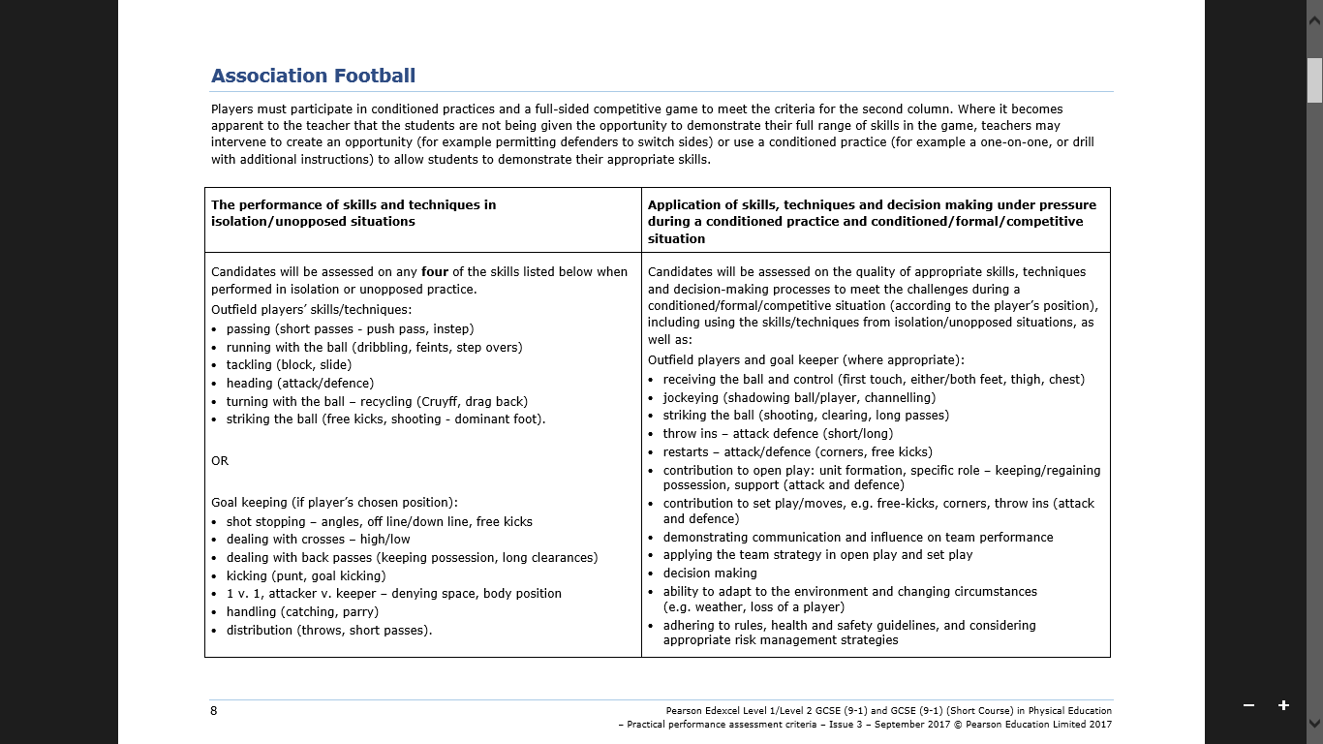
Before playing a match, you will do drills that show your ability on the skills above. You will get a mark out of 10 for these skills.
In a game, you will be assessed on how well you use the skills as you play in a team and verse another team. You will get a mark out of 25 for these skills.

Slide 2
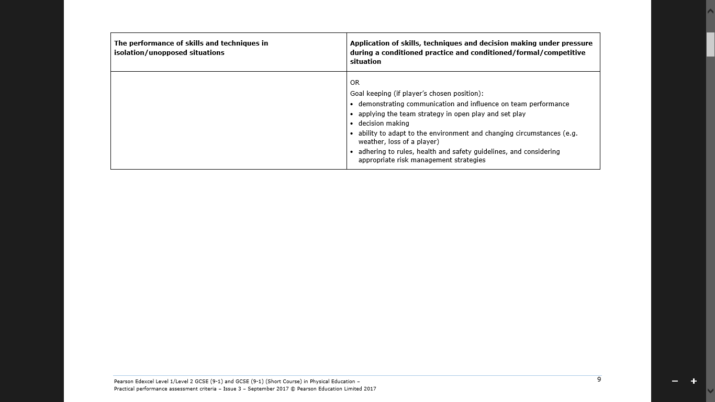
(Continued)

Slide 3
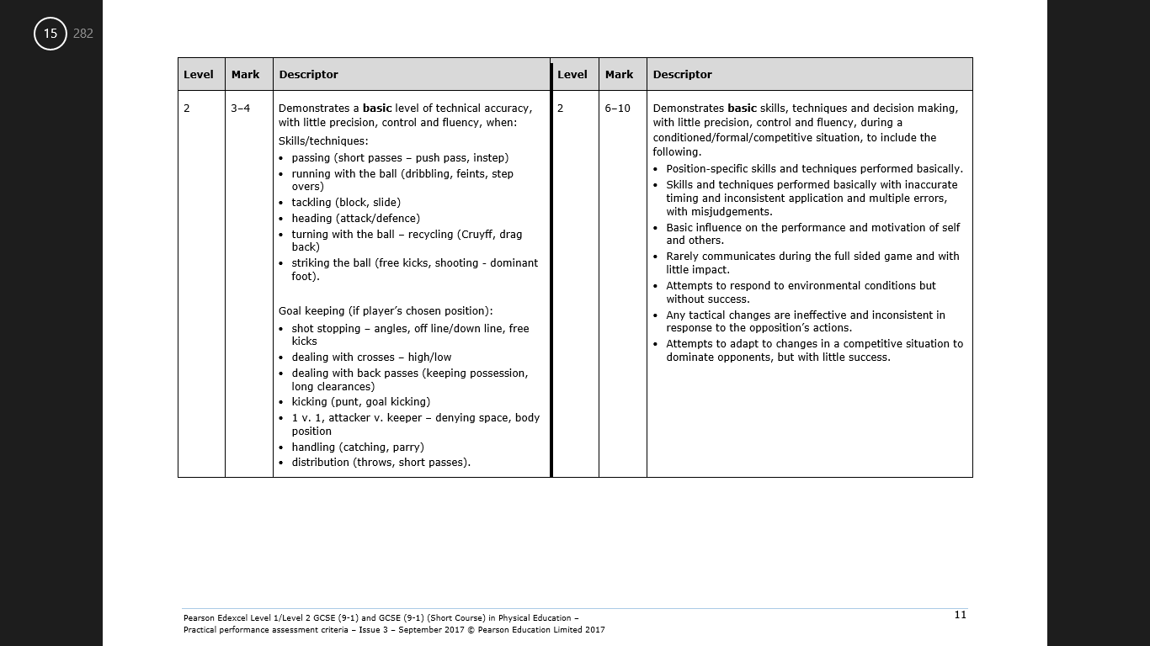
9-14 marks

Slide 4
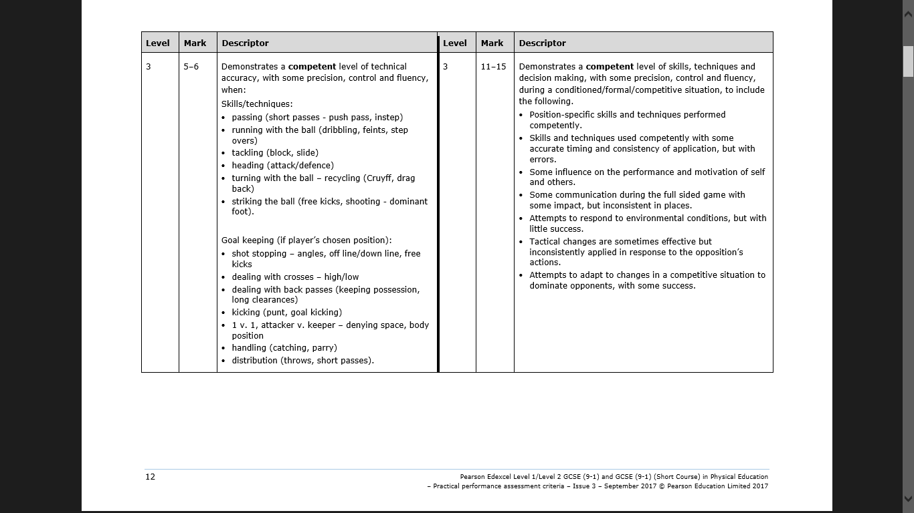
16-21 marks

Slide 5
23-28 marks

Slide 6
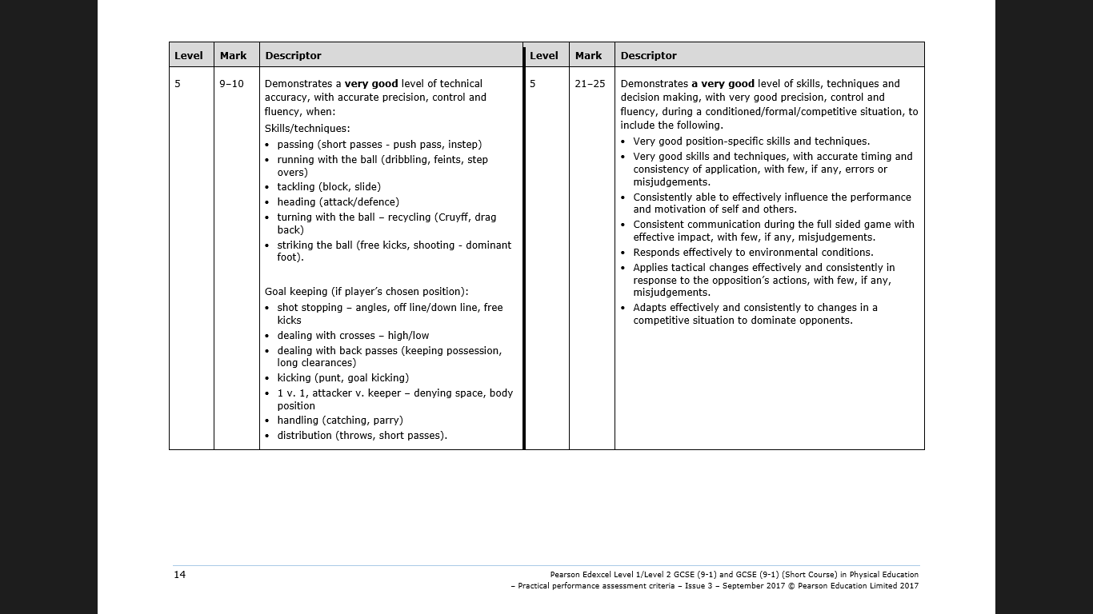
30-35 marks

