Slide 1
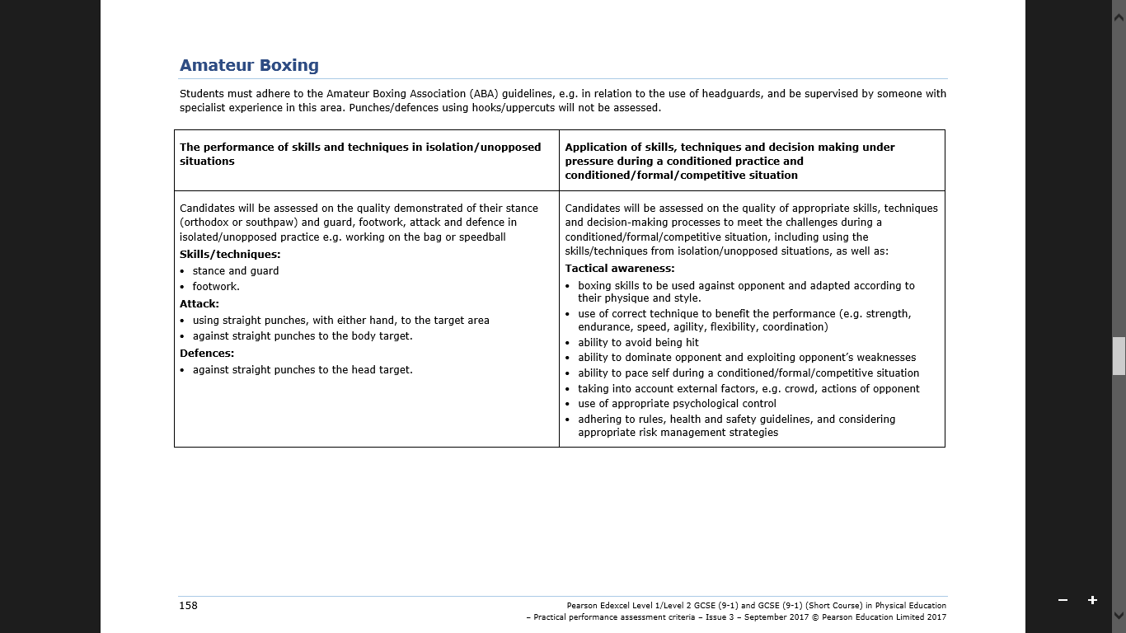
Before a match, you will do drills that show your ability on the skills above. You will get a mark out of 10 for these skills.
During a match, you will be assessed on how well you use the skills as you verse an opponent. You will get a mark out of 25 for these skills.

Slide 2
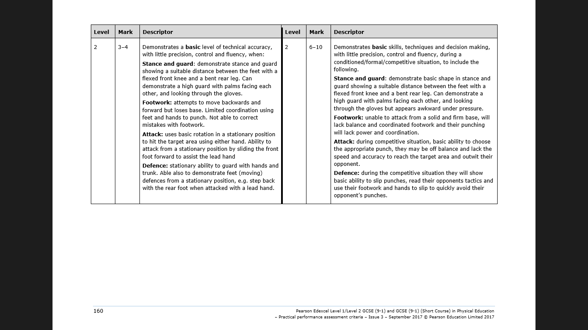
9-14 marks

Slide 3
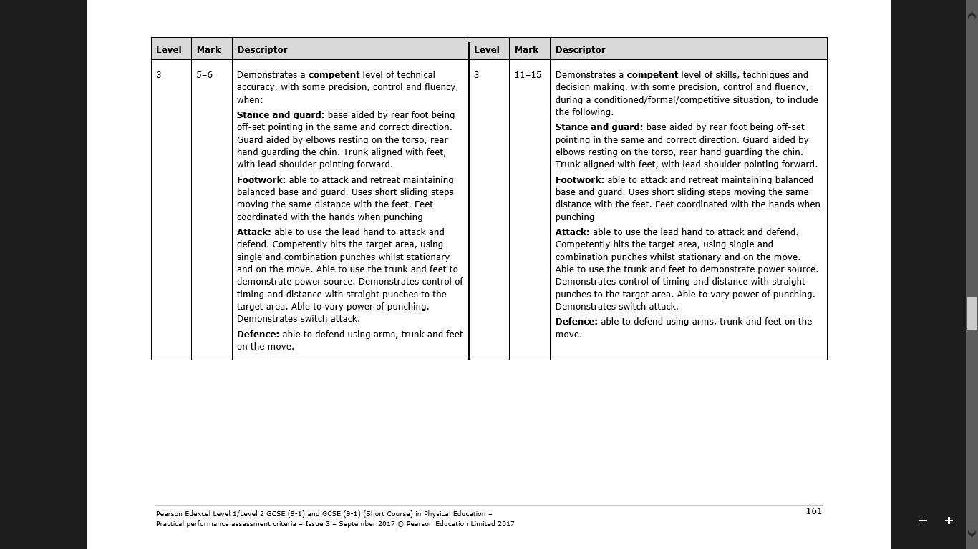
16-21 marks

Slide 4
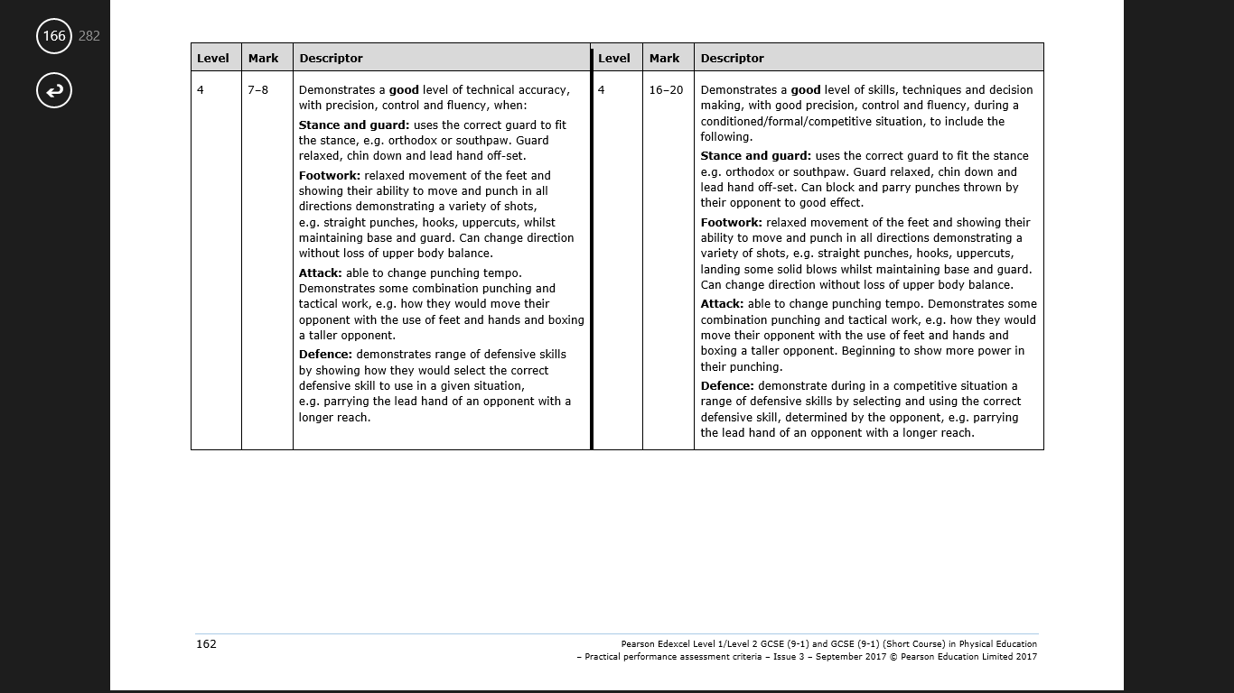
23-28 marks

Slide 5
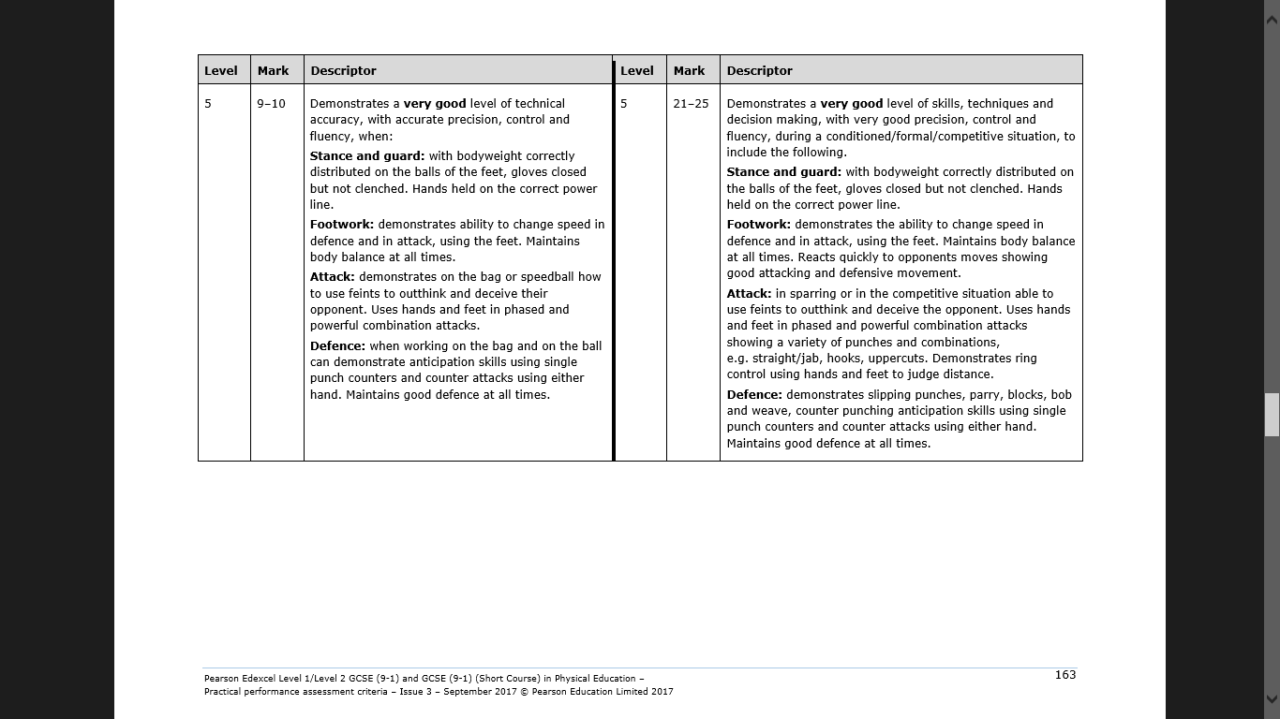
30-35 marks

